Slide 1


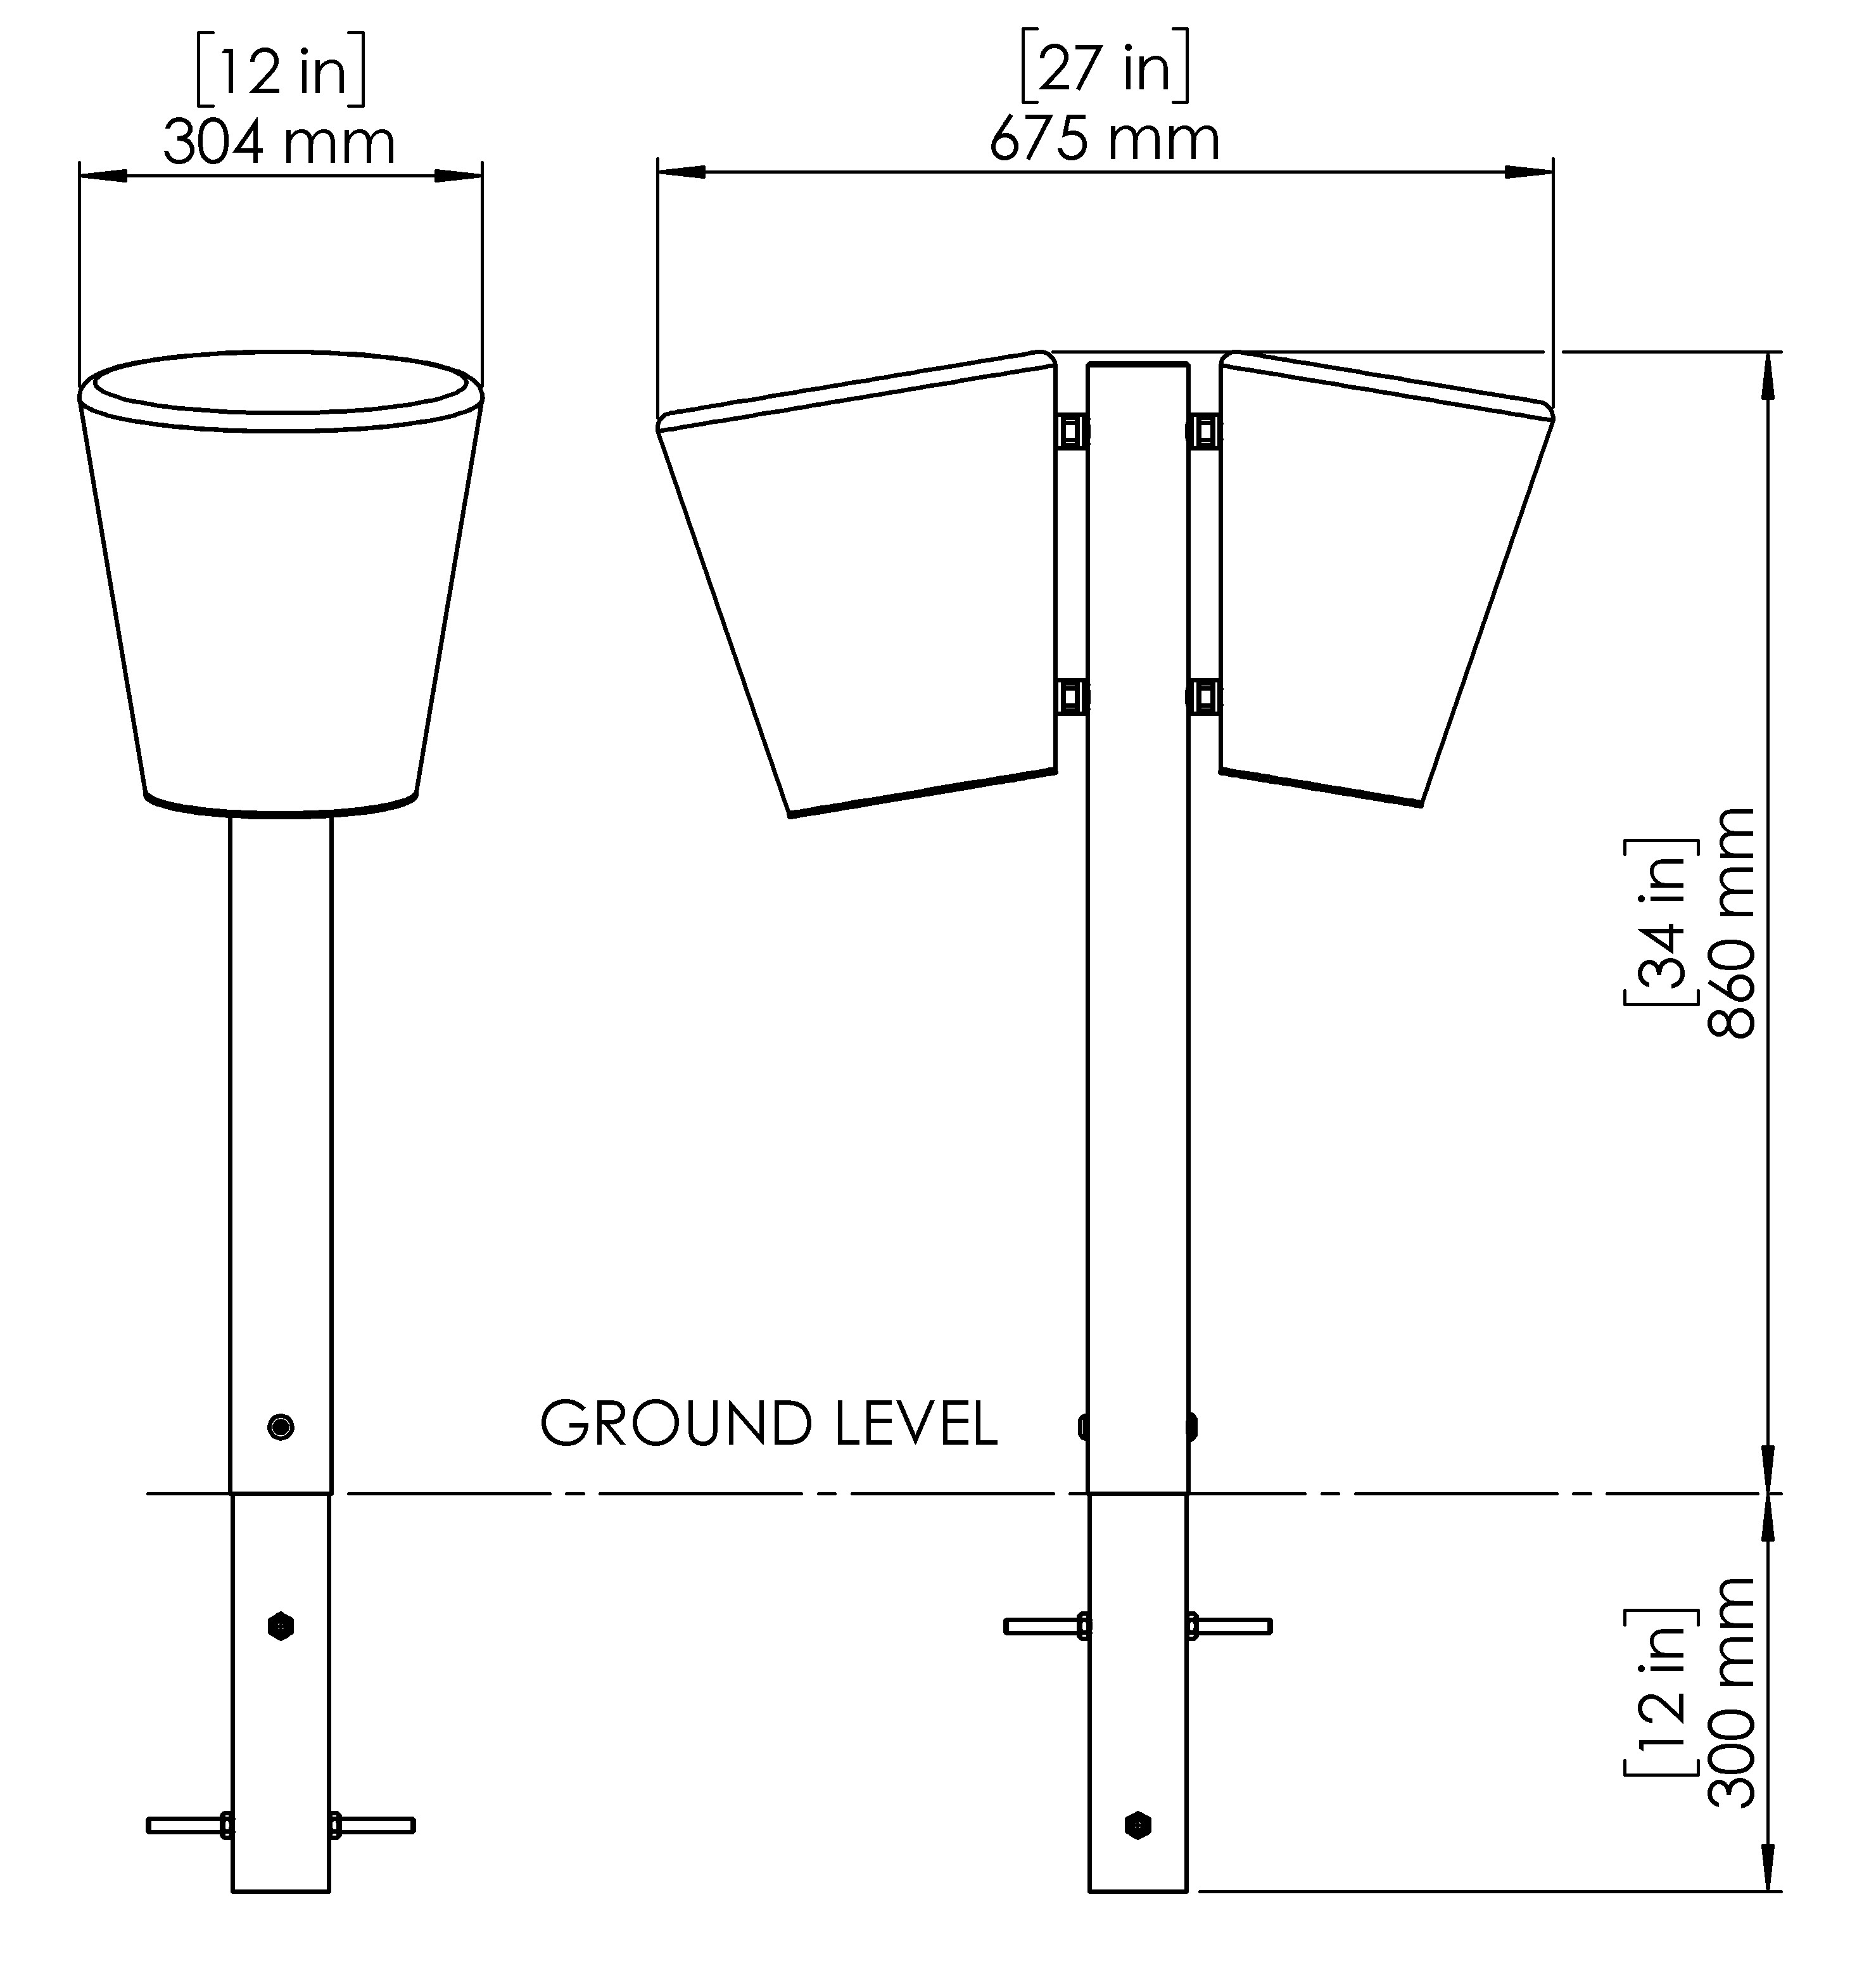




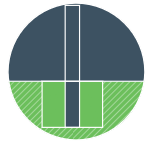
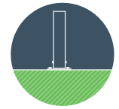



STREET CONGA DUO
(PP-STCO-DUO-SF/GF)
Street Congas Duo is an outdoor hand‑played percussion instrument with two stainless‑steel drum heads mounted on a single post. Played with fingers or palms, it requires no mallets and supports intuitive rhythmic play. Designed for permanent outdoor installation, it suits a wide range of public environments.
Surface Fix: Ground Fix: | 18 KG / 40 LBS 17 KG / 38 LBS
Materials | Stainless Steel
Tuning | Unpitched
Sound Level Data | 50M – 52dB 10m – 53dB <3m – 56dB
Warranty Download
View On Website
Wheelchair Accessible
Played with hands
Suitable for concreting into the ground
Suitable for surface fixing
Issue AA Date: 02/26

